Slide 1


Green Pace
Security Policy Presentation
Developer: Tyanna Prince

Slide 2

OVERVIEW: DEFENSE IN DEPTH
This security policy is being introduced so that all employees here at Green Pace can standardize principles and coding standards. Best security practices such as Triple-A framework and Defense in Depth are followed.

Slide 3
THREATS MATRIX
Likely MEM50-CPP STR50-CPP | Priority CTR51-CPP
Low priority IDS00-J ERR50-CPP | Unlikely MSC50-CPP FIO51-CPP OOP50-CPP NUM00-J DCL03-C

Slide 4
10 PRINCIPLES
1. Validate Input Data 6. Adhere to the Principle of Least Privilege Sanitize Data
STD-001-CLG Sent to Other Systems
STD-002-CPP STD-003-CPP
STD-003-CPP STD-004-CLG
STD-004-CLG 7. Sanitize Data Sent to Other Systems
STD-010-CLG STD-003-CPP
2. Heed Compiler Warnings STD-004-CLG
STD-001-CLG 8. Practice Defense in Depth
STD-005-CPP 9. Use Effective Quality Assurance Techniques
STD-005-CPP 10. Adopt a Secure Coding Standard
3. Architect and design for security policies STD-001-CLG
STD-004-CLG STD-002-CPP
STD-007-CPP STD-003-CPP
STD-009-CPP STD-008-CPP
4. Keep it Simple STD-009-CPP
STD-001-CLG
STD-009-CPP
5. Default Deny

Slide 5
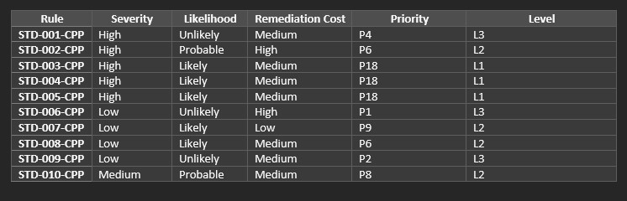
CODING STANDARDS

Slide 6
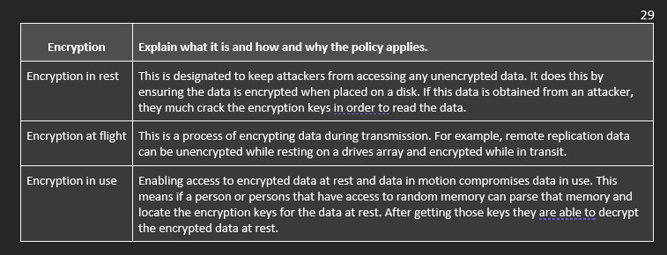
ENCRYPTION POLICIES

Slide 7
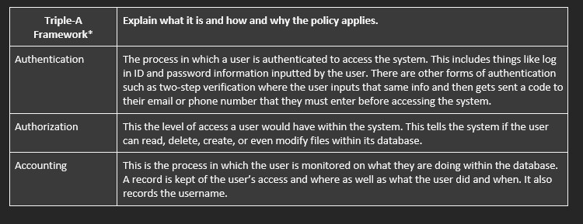
TRIPLE-A POLICIES

Slide 8
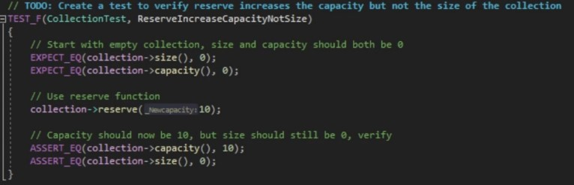
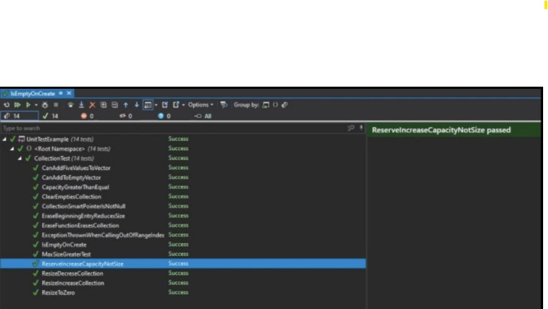
Unit Testing
Something very important when coding applications in C++ if memory management. We can use unit testing to check the functionality of reserving and or resizing data in memory for a container. This can be done without allocating any data.

Slide 9

AUTOMATION SUMMARY

Slide 10
TOOLS
The focus of DevOps is security protocols that start at the beginning, development, and testing phases of a project. By following secure standardized policies, you can ensure that operation here at Green Pace will be smooth. Devops is extremely crucial in development.
There are many tools we will use throughout the many stages of development. Tools like Clang and Astree are used in the very and test phase as well as other external tools that can help us verify the functionality of our code as well as detect any vulnerabilities. This will ensure that all security policies outlined are followed throughout the development process.

Slide 11
RISKS AND BENEFITS
The lack of automation and encryption makes the DevOps design not security minded.
Wait
Upfront costs are less
The production cycle is unbroken
difficult to manage
Act Now
Upfront costs are more with more effort
Development with security in mind starting from the beginning of SDLC
Few risks with post-production
Standardized practice for future development with more secure code

Slide 12
RECOMMENDATIONS
Use of external tools to run vulnerability checks
Triple-A Framework
Unit testing
Encrypt anything and everything

Slide 13
CONCLUSIONS
By taking steps starting from the beginning of development and implementing defense in depth as well as security testing will allow DevOps to transform to DevSecOps. By adopting ALL standards here at Green Pace we can improve the overall security of our systems which is of the most importance.

Slide 14
REFERENCES
No references were used to build this presentation

